Slide 1
What AFA Members
at Hawaiian Airlines
Need to Know About
FUMES ONBOARD
Created by the AFA-CWA

Slide 2
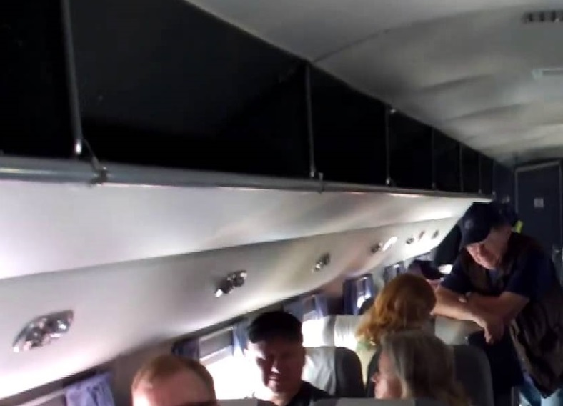
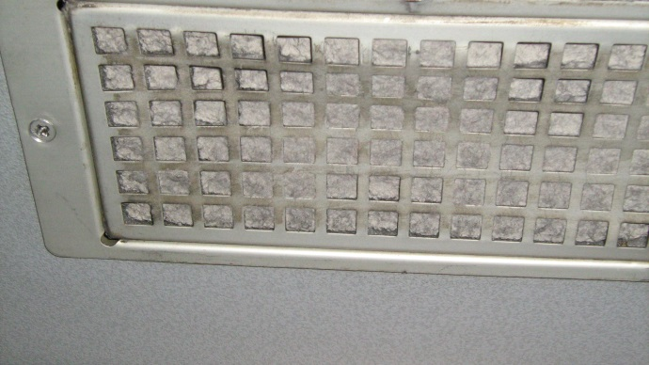
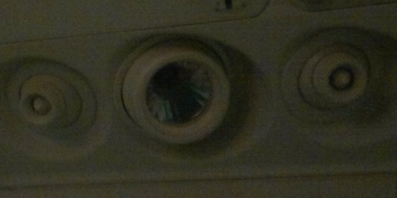
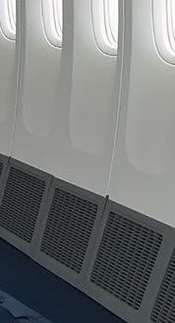
Where does cabin
air come from?
Onboard, the air you breathe in the cabin comes in through open gaspers, and vents at the top of the sidewalls, the main aisle, or both.
Air is “added” at the top of the cabin and then it is exhausted or pulled out of the cabin through floor level vents. About half of the “used” air gets dumped overboard and the other half gets recirculated.

Slide 3
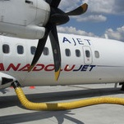
Did You Know?
Unless there’s one of these big, yellow hoses connected to the aircraft at the gate…
then the air coming in through the cabin vents has first passed through one of the aircraft engines or the APU, where it gets compressed and heated. The systems are designed to process compressed air because, when inflight the outside air is very cold and low pressure (i.e. low oxygen content). For this reason the air has to be made warmer and more dense before it is suitable to breathe. Ventilation air from the engines is called “bleed air” because it is “bled” off the engines!

Slide 4


To recap…
1
2
3
Outside air gets sucked in through the engine.
There it gets compressed and heated. Most of that hot air is used for “engine thrust” but some of it is “bled” off the engine, cooled, mixed, and routed into the cabin to be used for ventilation.
It’s delivered through the cabin vents above you.

Slide 5
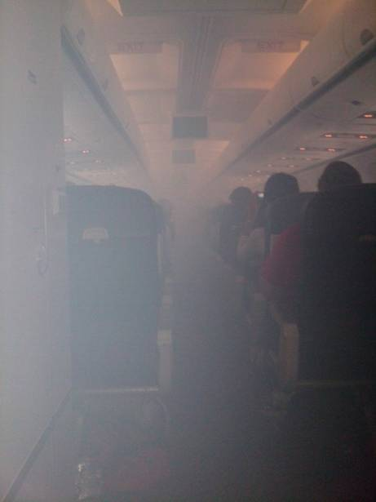
The problem is…
Air that comes through the engine compressors usually is not filtered!
Sometimes, engine oil or hydraulic fluid leak or spill into the hot engine compressor, resulting in fumes which contaminate the breathing air and are delivered into the cabin.
Sometimes you see a haze or smoke as well, like this…
However the most common indication is a bad odor. Which can make it difficult to be sure something is wrong.

Slide 6
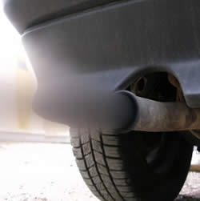
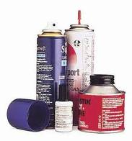
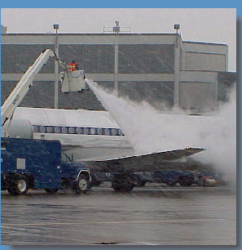
There are many sources of fumes onboard an aircraft! It may be challenging to determine which action is required.

Slide 7
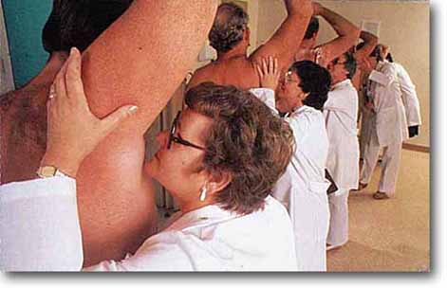



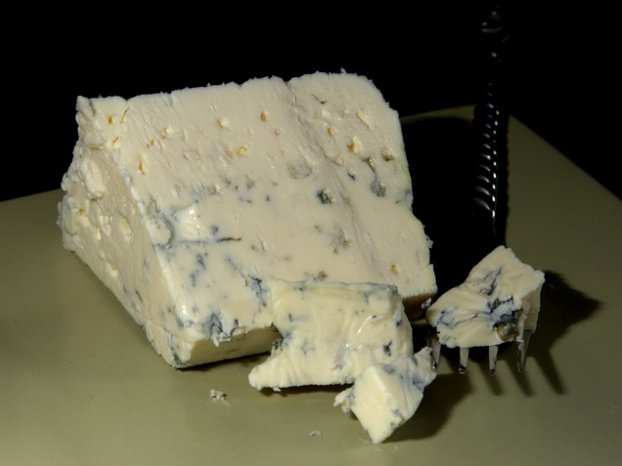
So which are just smelly but not toxic?

Slide 8
Two types of fumes coming from air vents demand the most attention
Engine Oil Fumes
  Can contain carbon monoxide gas and other toxins like tricresyl phosphates (TCPs)
  Breathing oil fumes can cause physical symptoms both immediate and long term. Symptoms such as speech problems & poor balance may not be obvious until a number of days after the incident.
Hydraulic Fluid Fumes
  Can also contain carbon monoxide gas and other toxins like tributyl and triphenyl phosphates (TBP, TPP)
  Breathing hydraulic fluid fumes can cause long-term symptoms such as chronic cough and rashes.

Slide 9
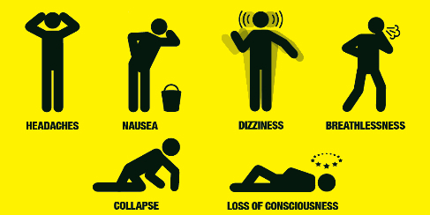
Potential symptoms of breathing fumes:
SLOWED THINKING
CONFUSION
FATIGUE/
Other symptoms include, acute stomach cramping and muscle aches. Hydraulic fluid fumes can also cause acute cough/sore throat and breathing issues. Exposure to any type of fumes can also cause chronic long-term symptoms.

Slide 10
What should you do if you notice an unusual odor onboard?
First, attempt to determine if the odor is coming from the AIR VENTS or SOMETHING IN THE CABIN.
If the odor is coming from a CABIN ITEM such as a carry-on bag or galley item, address directly.
If the odor is coming from the AIR VENTS, that COULD BE engine exhaust or deicing fluid if on the ground. If that is not the case OR if you aren’t sure and someone has symptoms, REPORT it to the flight deck.

Slide 11
WHAT should be reported to pilots?
Tell them FUMES are present in the cabin that appear to be coming from the air vents.
Confirm cabin items have been ruled out.
Report what it smells like.
If any smoke/haze is present.
When were the fumes first noticed (e.g., engine start, top of descent, etc.).
Where in the cabin is it most noticeable, or not noticeable.
Report if anyone is ill and needs medical attention.

Slide 12
WHEN do you tell the pilots?
Assess the cabin situation promptly and then report the details to the pilots immediately!
If the ventilation air IS contaminated with oil or hydraulic fluid fumes, it is a safety of flight issue. For that reason, calling the cockpit even during sterile cockpit would be warranted.
During critical phases of flight pilots are typically under a high workload. They may not answer your call immediately as they are trained to aviate and navigate before they communicate! However they need to know about any issues of fumes onboard.

Slide 13


What to do after a fume exposure and you feel sick:
If you have symptoms of carbon monoxide exposure, take oxygen for first aid purposes and report your symptoms.
If anyone requires additional medical attention, have the Captain request for EMS upon arrival. If you have symptoms of carbon monoxide exposure, EMS may be able to test your level of exposure with a finger clip type device (non-invasive). Report any oxygen usage because it will influence the test result.
The most accurate way to test for carbon monoxide exposure is to go immediately and directly from the aircraft to the hospital ER to get a blood test.
  If you go to the hospital bring these documents with you:
  Health Care Providers’ Guide
  Safety Data Sheet for either OIL or HYDRAULIC FLUID that Hawaiian uses (see next slide...)
Notify an Inflight manager, that you are ill and start workers’ comp procedures.
Make sure you submit a report via Wbat and check the box to send a copy to AFA Safety.

Slide 14


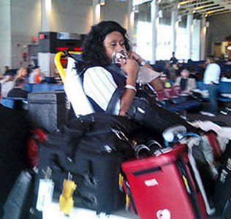
Hold on!!
Got some questions!!
Which engine oil and hydraulic fluid does Hawaiian use?
  Hawaiian uses MOBIL JET OIL 254 – click HERE for the safety data sheet.
  Hawaiian uses Skydrol PE5 hydraulic fluid – click HERE for the safety data sheet.
What if I don’t know what was in the air?
  No airline monitors the cabin air for chemicals because the FAA does not require it. Without data, it’s sometimes hard to know what was in the air.
  However, the SOURCE of the fumes provides a clue: Was it coming from the vents? Or from something inside the cabin?
  The ODOR is another clue: Oil fumes are often (but not always) described as smelling like dirty socks, moldy, musty, or foul. Hydraulic fluid is often described as acrid.
  The type of SYMPTOMS is a clue as well: Hydraulic fumes often result in coughing, burning throat, and eyes. Where as oil fumes typically report less respiratory issues but more brain symptoms such as headaches.
  Tell the doctor what you know and how you feel. Give the doctor the FAA Health Care Providers’ Guide. If fumes came from the vents and odor, symptoms consistent with oil or hydraulic, then give the doctor the safety data sheets or at least the names of the relevant products.
  AFA is here to help.

Slide 15
What your doctor needs to know:
How fumes can contaminate cabin air: Give the doctor the “Health Care Providers Guide”. This was written by a doctor and funded by the FAA.
The types of fumes you likely inhaled onboard: Give the doctor the Safety Data Sheet for either the oil or hydraulic fluid that Hawaiian uses (whichever you believe is relevant to your flight).
There are no blood test specific to oil/hydraulic fluid exposures: But if your symptoms are consistent with carbon monoxide exposure, it is worth getting tested. Note how many hours have passed since you breathed the fumes, and also if you have taken oxygen since then. Those two factors will influence the amount of carbon monoxide in your blood. Other chemicals to test for after oil fume exposure are N-hexane and methyl pentane. They are not specific to oil fumes, but are likely present, which would indicate exposure.
Other blood tests that may be helpful are: serum cholinesterase (to monitor the change in activity of this enzyme, needs to be tested multiple times during the 1-2 weeks post-exposure) and serum c reactive protein (general marker of inflammation).

Slide 16
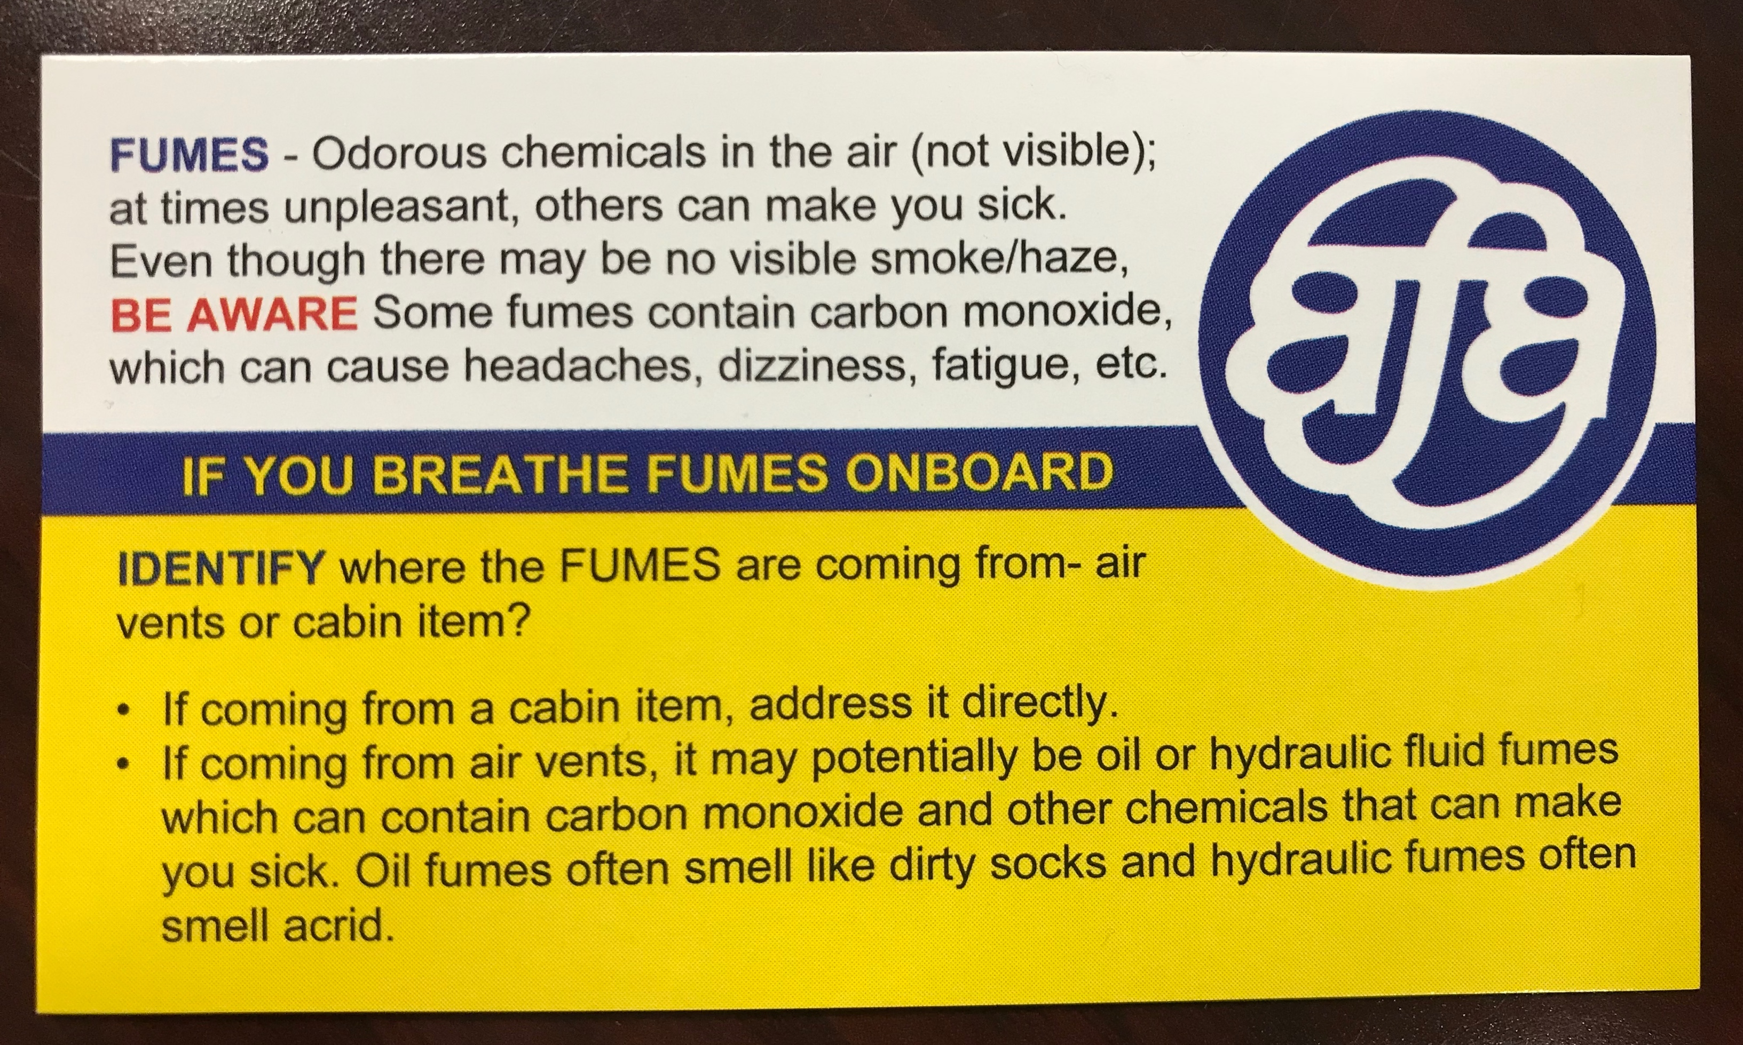
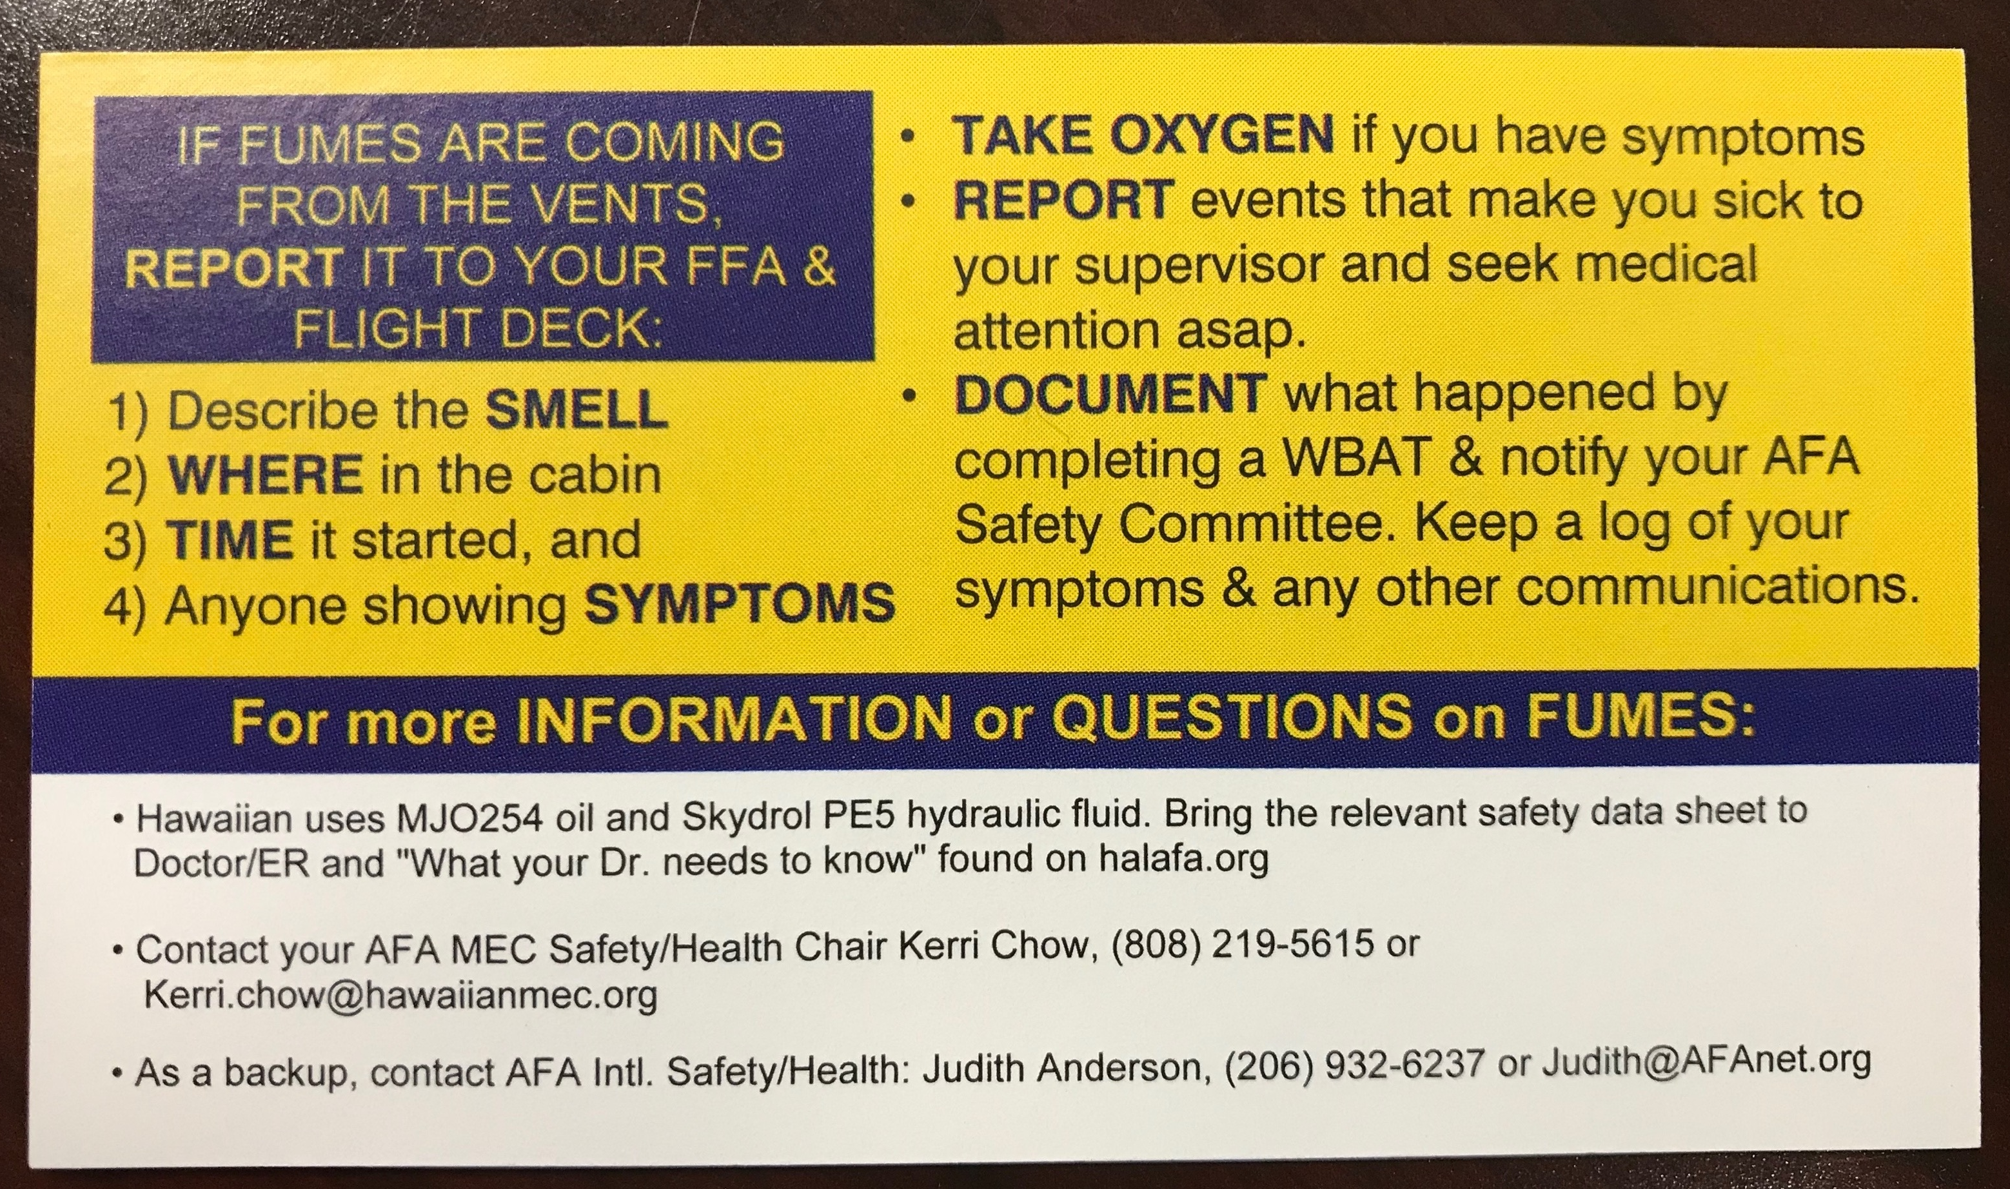
Your AFA MEC has printed and distributed fume event information cards and posted pertinent information at HawaiianAFA.org
Keep this AFA fumes card with you when you fly. Also, visit the MEC webpage for additional advice and documents! Also, visit the AFA International Cabin Air webpage for general advice and practical documents.

Slide 17
Let’s review…
Pay attention to the presence of odors and fumes onboard, even if there is no visible smoke or haze. Some fumes just smell unpleasant, others can make you sick.
Do your best to identify the SOURCE of fumes. Is it coming from the vents, or somewhere in the cabin?
If fumes are from vents, REPORT to the pilots, even during sterile cockpit because breathing fumes can create a flight safety issue. If the pilots can’t take your call, they will communicate when they can.
If you have symptoms consistent with breathing carbon monoxide, take oxygen for first aid purposes. Get checked on landing.
Still feel unwell? Seek medical attention. Breathing fumes can also cause long-term symptoms, some with a delayed onset. Bring the Health Care Providers’ Guide and relevant Safety Data Sheets.
Document, document, document!
Report to your AFA MEC Safety Chair. AFA is here to help.

Slide 18
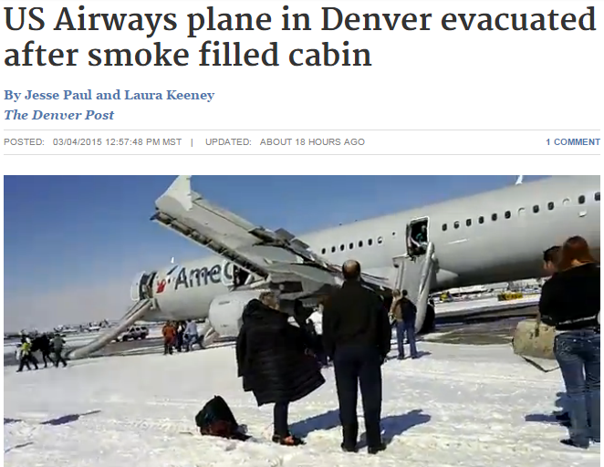
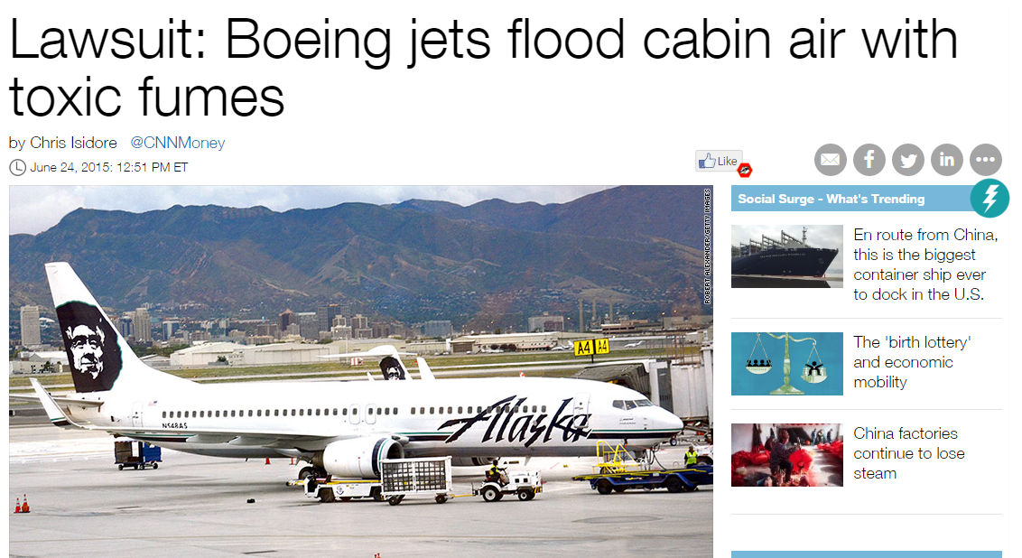
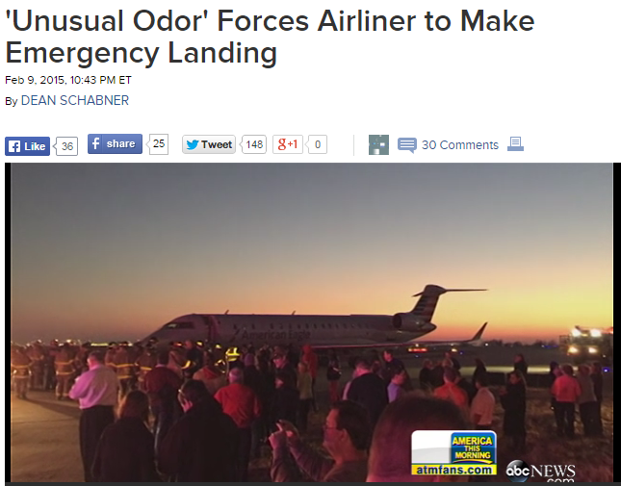
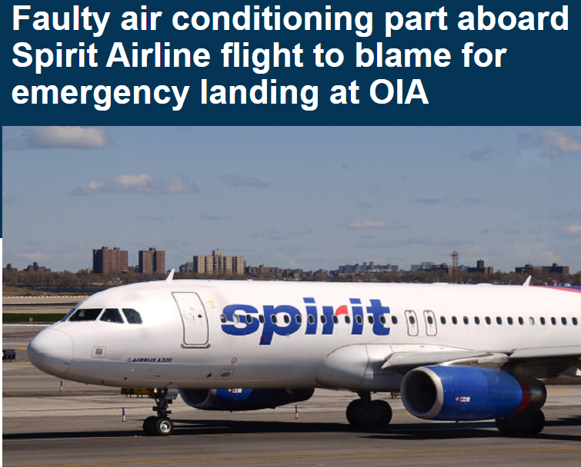
Remember: Some fumes are just unpleasant. Some
fumes can make you sick. Recognize and respond as needed.

Slide 19

Put your health and safety first.
Questions?
Contact Kerri Chow, AFA-CWA
MEC Air Safety, Health & Security Chair kerri.chow@hawaiianmec.org
(808) 219-5615
As backup, you may also contact AFA-CWA International
Air Safety, Health, & Security Department’s
Judith Anderson - judith@AFAnet.org

